Slide 1
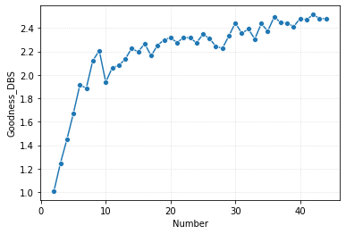
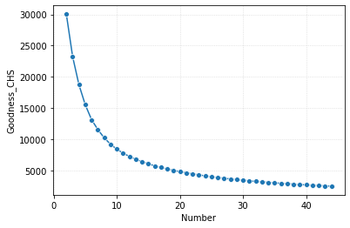
100%
Davies_bouldin_score
Calinski_harabasz_score
20-44

Slide 2
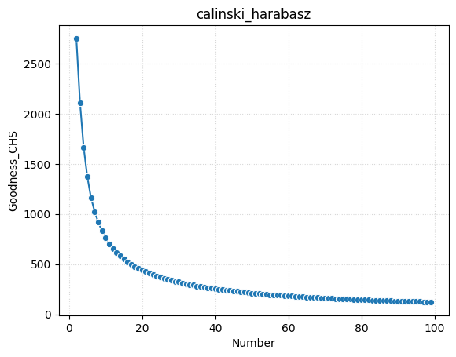
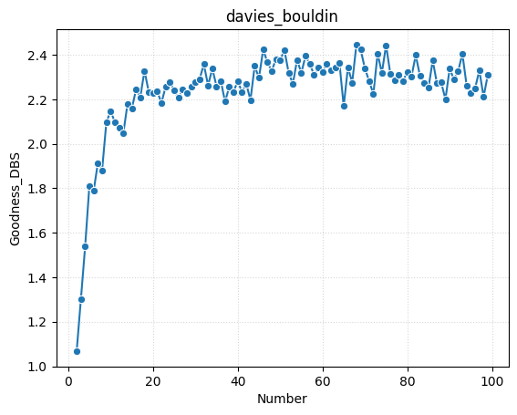
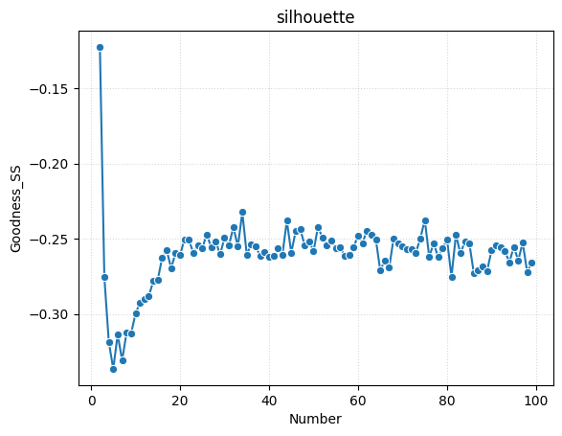
10%
Calinski_harabasz_score
Davies_bouldin_score
silhouette_score
2-100

